Slide 1
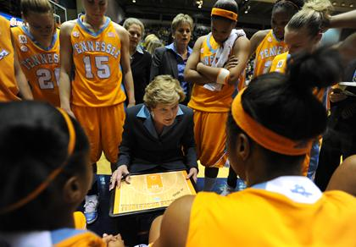
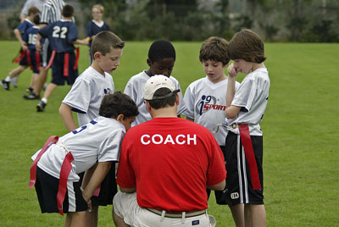
The Influence of Coaches on Athletes’ Confidence
By: Bailey Tyler

Slide 2
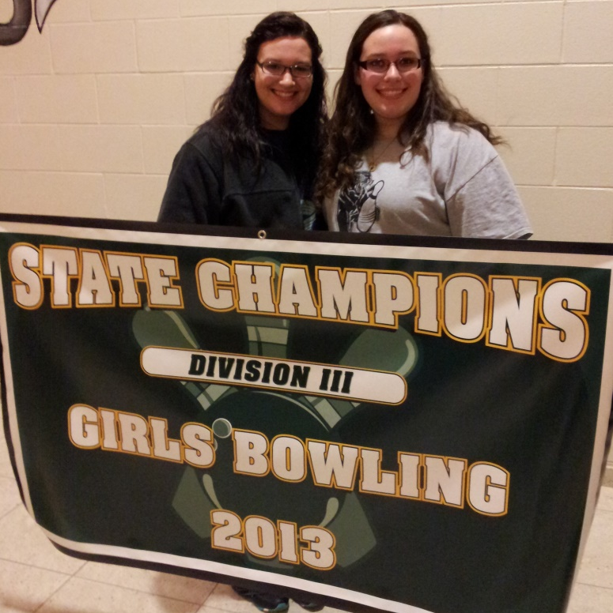
High School Varsity Bowling Team – 4 Years
Graduated in 2012
Community College & Volunteered as a JV Bowling Coach

Slide 3
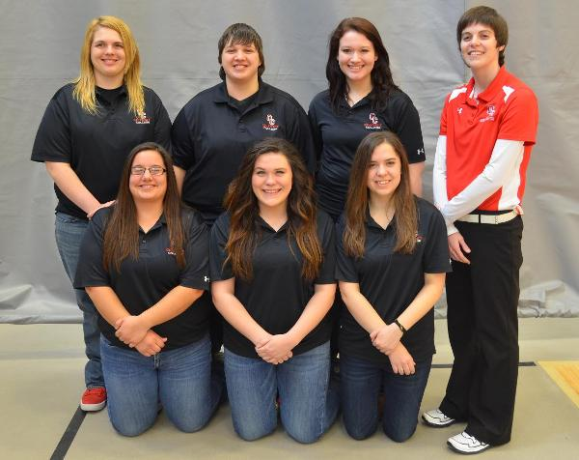
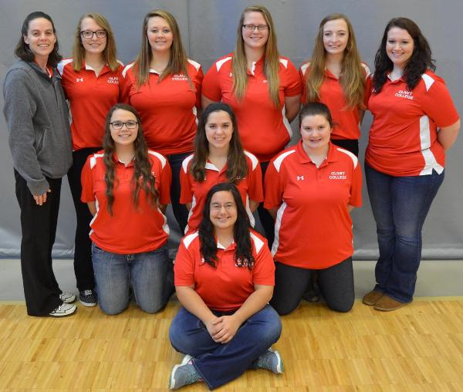
Recruited to bowl for Olivet College
Captain 2 consecutive years
All-American???????
Graduating in May 2017
Majoring in Sports Psychology
Minoring in Coaching

Slide 4
Overview
What is Confidence?
Coaches’ Expectations
Feedback & Athletes’ Self-Perception
Verbal and Non-Verbal Communication
The Cycle of Communication
Coaching Behavior Questionnaire
Coach vs Player Perceptions

Slide 5
Confidence
“a feeling or belief that you can do something well or succeed at something”
Webster's Dictionary

Slide 6
Expectations of an Athlete
Low expectations = low performance
Behavior of Coach
Emphasize mistakes of athlete
Ignore successes
Behavior of Athlete
No drive to succeed (motivation)
Low self-confidence
Distraction from task at hand

Slide 7
Expectations of an Athlete cont’d
High expectations = high performance
Behavior of Coach
Encouragement
Personal one-on-one help
Expectation to succeed
Behavior of Athlete
Pride in accomplishments
High confidence
High motivation

Slide 8
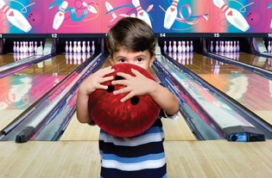
Feedback & Athletes’ Self Perception
Feedback = Athletes’ Evaluation Self Competence
Situation Specific
Practice behavior is more influential than game day behavior
Low skill level athletes vs. High skill level athletes
Notes:
Pictures with “small freshman” vs “super senior”
Ask coaches who has used these phrases before with a young or new to bowling athlete?

Slide 9
“Good Job!” “Good Game!” “You’re Doing Great!”
“That was a great shot!” “You’re Amazing!”
Constructive feedback will make or break an athletes’ self evaluation about their competence level!
REMEMBER WHO
YOU’RE TALKING TO!
Notes:
Insert: blah blah blah or someone talking on this page.
Excessive praise with small or medial tasks

Slide 10
The Sandwich Method
“You’re doing a really good job hitting your mark. In the future work on keeping your knees bent but your form otherwise looks really good.”

Slide 11
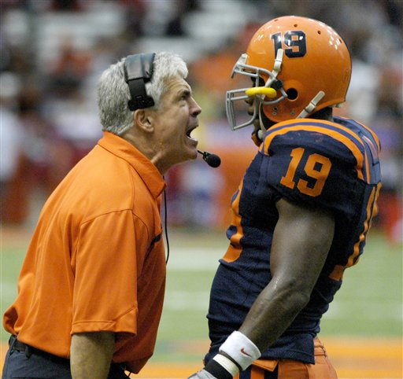
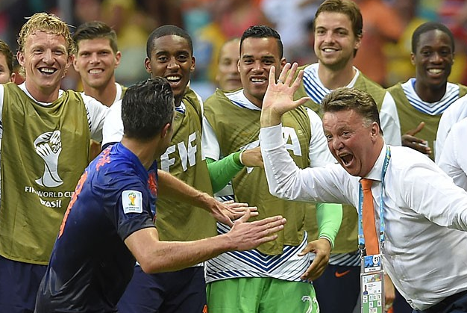
Coaches’ Physical (Non-Verbal) Behavior
Coach reacts with body language
All emotions
Athlete perceives and interprets behavior
Recall any previous interactions

Slide 12
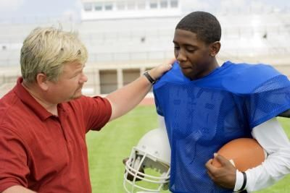
Coaches’ Physical (Non-Verbal) Behavior
Athlete evaluates behavior and reacts
Is the behavior common/rare?
Coach evaluates athlete’s reaction
Likes reaction = encouragement
Dislikes reaction = distrust of athlete/disrespect

Slide 13
Coaches’ Physical Behavior cont’d
Smoll & Smith 1989

Slide 14
Coaching Behavior Questionnaire (CBQ)
Evaluates five aspects of coaching behavior:
Cognitive/attentional effects of coaching behavior
Emotional outbursts from my coach help me get fired up.
Supportiveness
My coach shows support for me even when I make a mistake.
3. Emotional control and composure
My coach controls his/her emotions well during games.
4. Communication
Criticism from my coach is done in a constructive manner.
5. Somatic (physical) effects of coaching behavior
My coach’s behavior during a game makes me feel tight and tense.

Slide 15
CBQ Application
Kenow & Williams
Female Basketball Players
Competitive trait anxiety
Competitive state anxiety
Somatic anxiety
Self-confidence
Perception evaluation of coach’s behaviors (CBQ)
Results:
High trait/cognitive anxiety & low self-esteem = perception of coach’s behaviors negatively
Low trait/cognitive anxiety & higher self-esteem = perception of coach’s behaviors positively

Slide 16
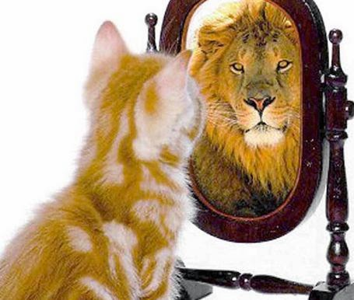
Players’ vs. Coaches’ Perceptions
Discrepancies between players’ and coaches’ perceptions of the same behavior
The Coaching Behavior Assessment System:
Twelve categories of reactive and spontaneous coaching behaviors
Eighty-one Professional Basketball Players
Eight Head Coaches
Notes:
Perception clipart

Slide 17
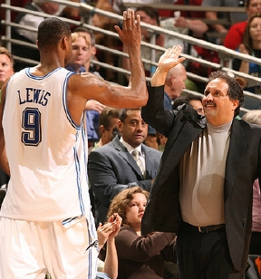
Results
Coaches’ perceived their behavior as being more supportive
Players’ perceived and recalled coaching behavior more negatively
Biggest Discrepancies:
Technical instructions after mistakes
Reward good plays/efforts
Training organization
Ignoring mistakes
Notes:
Pics?

Slide 18
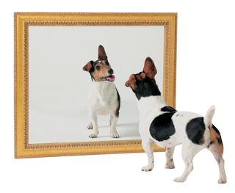
Self-Awareness!
As coaches this is our biggest obstacle
We are mostly unware of personal behaviors
Talk with assistants, athletes, parents
Notes:
Pics assistants athletes parents

Slide 19
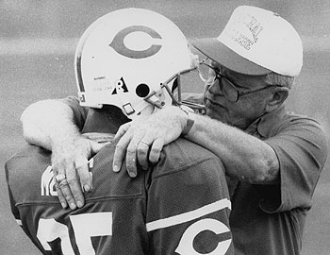
Implementation
Keep practice and game day behavior the same!
Have athletes repeat your words back to you
“Bank” information/remember this feeling

Slide 20
In Conclusion:
Our expectations can influence our athletes to either reach for their best or fall below their potential.
Our ability to give feedback will be vital to our athletes’ self perceptions.
Non-verbal behavior will play an equal role to physical behavior.
How athletes’ perceive behavior may be different than how a coach intended it to be taken.
EVERY ATHLETE IS DIFFERENT!

Slide 21
References
Williams, J. et. al. (2003). Factor Structure of the Coaching Behavior Questionnaire and Its Relationship to Athlete Variables. The Sport Psychologist. Retrieved from https://the-coach-athlete-relationship.wikispaces.com/file/view/CBQ%20Article.pdf/182204039/CBQ%20Article.pdf
Coach-Athlete-Relationship Surveys https://the-coach-athlete-relationship.wikispaces.com/Surveys (Coaching Behaviors Questionnaire)
Lemonidis, N. et. al. (2014). Coaching Behavior in Professional Basketball: Discrepancies Between Players’ and Coaches’ Perceptions. Nova Science Publishers. Vol 6:1.
Horn, T. (1985). Coaches’ Feedback and Changes in Children’s Perceptions of Their Physical Competence. The American Psychological Association. Vol 77:2.

